Slide 1

Algorithms & Data Structures
Week 4
Trees

Slide 2
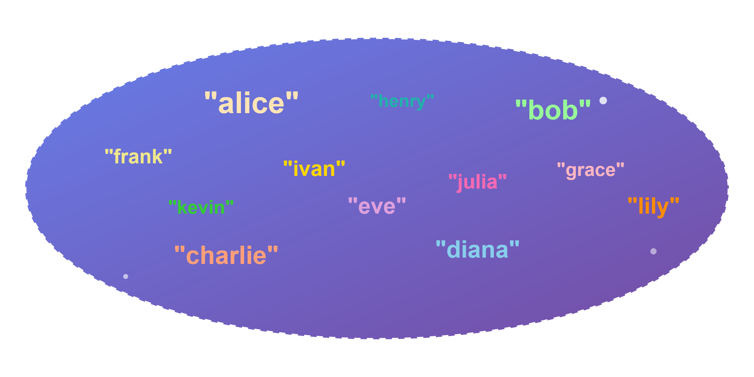
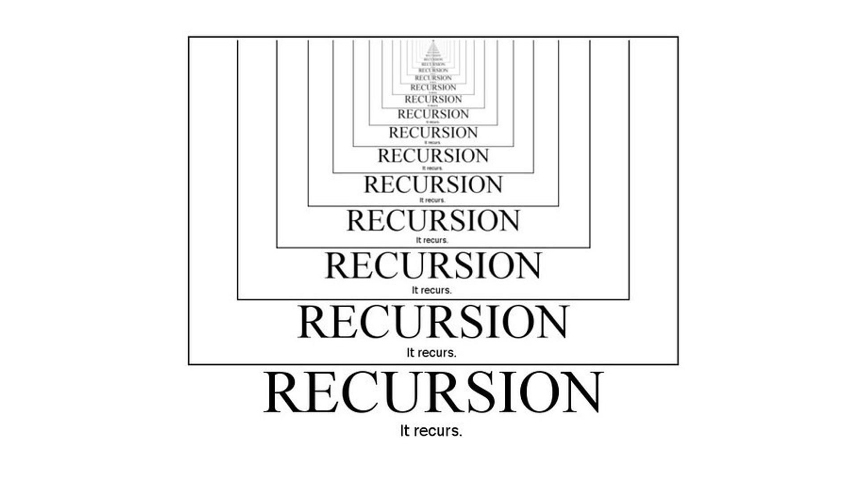
Last three weeks we discussed…
Sets:
  Arrays: good for searching (binary search), bad for inserting / removing
  Linked lists: good for inserting / removing, but bad for searching
Recursion
  Good for solving problems that are composed of similar subproblems
Today we will improve our Sets, apply recursion and then work around recursion

Slide 3

Hiearchical data structures
Using links to divide & conquer

Slide 4
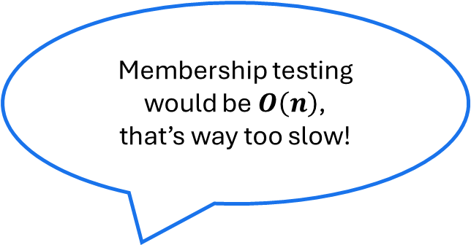
Revisiting linked lists
Let’s use a linked list to store the elements of a Set
Apple
Banana
Cherry
Date
Mango
Orange
Pear
head
Membership testing would be $O\left(n\right)$,
that’s way too slow!

Slide 5
Revisiting linked lists
Let’s use a linked list to store the elements of a Set
Apple
Banana
Cherry
Date
Mango
Orange
Pear
head
Membership testing would be $O\left(n\right)$,
that’s way too slow!

Slide 6
Revisiting linked lists
Membership testing would now be faster!
Let’s use a linked list to store the elements of a Set
root
Date
Banana
Orange
Apple
Cherry
Mango
Pear

Slide 7
Revisiting linked lists
Membership testing would now be faster!
Let’s use a linked list to store the elements of a Set
root
Date
Banana
Orange
Apple
Cherry
Mango
Pear

Slide 8

Trees
This data structure is called a Tree
Every “Node” has one parent node and several child nodes
The parentless “top” node is called the root
Nodes without children are called leaf nodes
root
Parent
node
Date
Banana
Orange
Apple
Cherry
Mango
Pear
Child node
Child node

Slide 9
Binary Trees
In a binary tree, each node has up to two children
Usually no need to refer back to parent node
struct Node {
string data;
Node* left{};
Node* right{};
}
root
Parent
node
Date
Banana
Orange
Apple
Cherry
Mango
Pear
Child node
Child node

Slide 10
Binary Search Trees
struct Node {
string data;
Node* left{};
Node* right{};
}
If we keep nodes sorted, we can easily search for values: Binary Search Tree (BST)
Sorting means that for every node:
  Every node to the left of it contains a smaller (or equal) value
  Every node to the right of it contains a greater value
root
Date
Banana
Orange
Apple
Cherry
Mango
Pear

Slide 11
Binary Search Trees
Which of these trees is (not) a binary search tree?
48
42
19
67
11
51
5
27
63
75
2
27
48
63
2
11
42
51
99
5
19
67
99
Tree A
Tree B

Slide 12
Binary Search Trees & Sets
struct Node {
string data;
Node* left{};
Node* right{};
}
We can use a BST to implement a Set!
Need to provide:
  Membership testing / searching for value
  Insertion of a new value
  Removal of an existing value
root
Parent
node
Date
Banana
Orange
Apple
Cherry
Mango
Pear
Child node
Child node

Slide 13
BST – Membership test
Is “Cherry” contained in the set?
struct Node {
string data;
Node* left{};
Node* right{};
}
Search for a value: starting from root
  Node’s data “smaller” than value: move left
  “Greater” than value: move right
  End if found or if we reach a nullptr
root
current
Date
bool find(Node* root, const string& val) {
if (!root) return false;
if (root->data == val) return true;
if (val < root->data)
return find(root->left, val);
else return find(root->right, val);
}
Banana
Orange
Apple
Cherry
Mango
Pear

Slide 14
Interlude: BSTs & Recursion
struct Node {
string data;
Node* left{};
Node* right{};
}
A tree is a so-called recursive data structure
  Each node in a a binary tree can be seen as the “root” of a smaller “sub” tree
Recursion is a natural technique to traverse a tree.
Can often be replaced with loops, if traversal is downwards only
root
Date
Banana
Orange
Apple
Cherry
Mango
Pear

Slide 15
BST – Insertion
Insert “Fig” into the set.
struct Node {
string data;
Node* left{};
Node* right{};
}
Similar to membership test
New nodes are inserted as leaf nodes
Passing a reference to a pointer…
root
root
bool insert(Node*& root, const string& val) {
if (!root) {
root = new Node{val};
return true;
}
if (root->data == val) return false;
if (val < root->data) return insert(root->left, val);
else return insert(root->right, val);
}
Date
Banana
Orange
Apple
Cherry
Mango
Pear
Fig

Slide 16
BST – Removal (easy case)
Remove “Mango” from the set.
struct Node {
string data;
Node* left{};
Node* right{};
}
Removing is (relatively) easy if the Node is a leaf or has one child
Parent “adopts” “grandchild” as left / right child
root
root
Date
Banana
Orange
Apple
Cherry
Mango
Pear
Fig

Slide 17
BST – Removal (easy case)
Remove “Mango” from the set.
struct Node {
string data;
Node* left{};
Node* right{};
}
Removing is (relatively) easy if the Node is a leaf or has one child
Parent “adopts” “grandchild” as left / right child
root
root
Date
Banana
Orange
Apple
Cherry
Mango
Pear
Fig

Slide 18
BST – Removal (easy case)
Remove “Mango” from the set.
struct Node {
string data;
Node* left{};
Node* right{};
}
Removing is (relatively) easy if the Node is a leaf or has one child
Parent “adopts” “grandchild” as left / right child
DIY: Assignment 1
root
root
Date
Banana
Orange
Apple
Cherry
Fig
Pear

Slide 19
BST – Removal (tricky case)
Remove “Date” from the set.
struct Node {
string data;
Node* left{};
Node* right{};
}
Node has two children: can’t just remove node
Instead, replace its value with another one
  Remove node holding that other value
Which value to copy?
root
root
Cherry
Date
Banana
Orange
Apple
Cherry
Cherry
Fig
Pear

Slide 20
BST – Removal (tricky case)
Replace G
F
A node’s value can safely be replaced by:
  Greatest value in its left subtree
  Smallest value in its right subtree
The nodes that hold these values are guaranteed to have at most one child node
Remove node with two children:
  Copy value from greatest/smallest value in left/right subtree
  Then remove node from which value was copied
G
D
J
B
F
H
K
A
C
E
L

Slide 21
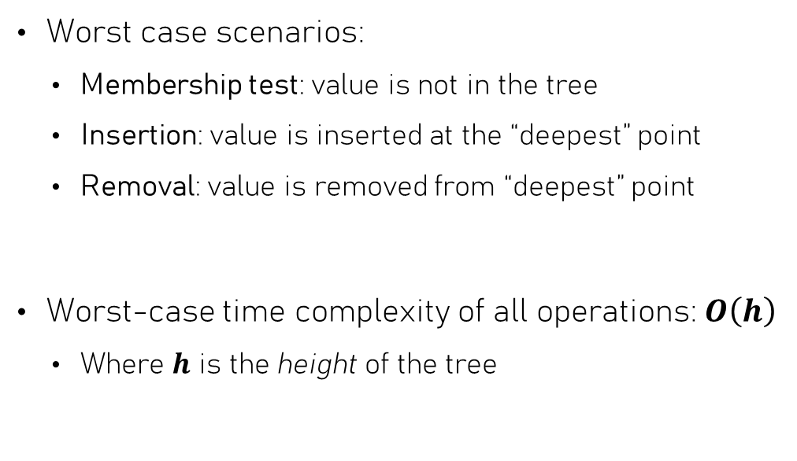
Binary trees as sets: Time Complexities
Worst case scenarios:
  Membership test: value is not in the tree
  Insertion: value is inserted at the “deepest” point
  Removal: value is removed from “deepest” point
Worst-case time complexity of all operations: $O\left(h\right)$
  Where $h$ is the height of the tree
G
D
J
Tree height
B
F
H
K
A
C
E
L

Slide 22
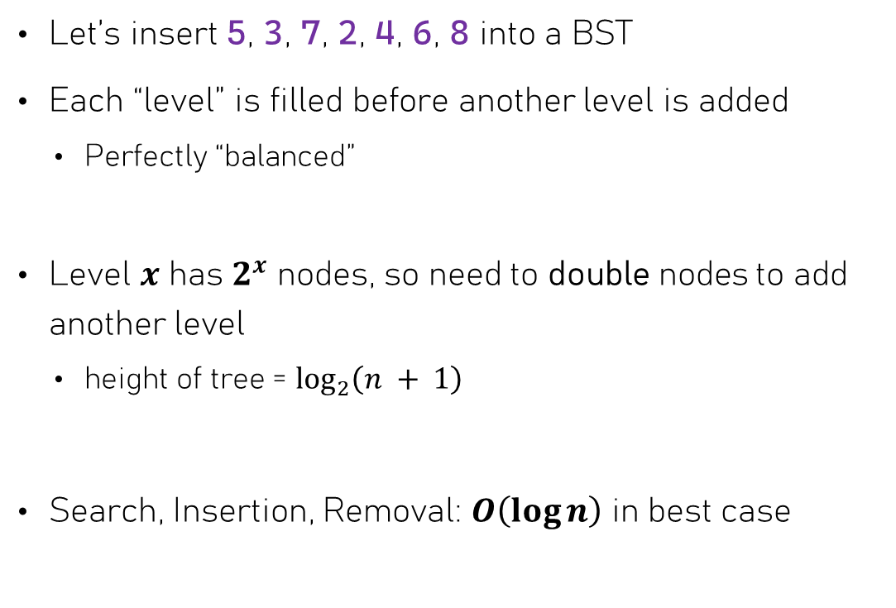
BST Time complexity – Best case
Let’s insert 5, 3, 7, 2, 4, 6, 8 into a BST
Each “level” is filled before another level is added
  Perfectly “balanced”
Level $x$ has $2^{x}$ nodes, so need to double nodes to add another level
  height of tree = $\log_{2}\left(n + 1\right)$
Search, Insertion, Removal: $O\left(\log{n}\right)$ in best case
5
level 0
3
7
level 1
2
4
6
8
level 2

Slide 23
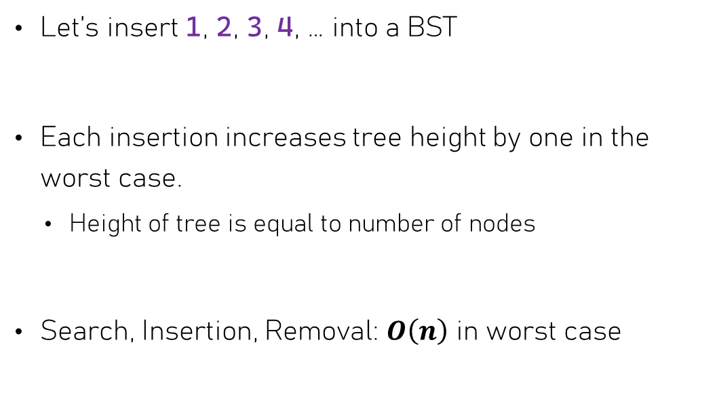
BST Time complexity – Worst case
1
Let’s insert 1, 2, 3, 4, … into a BST
Each insertion increases tree height by one in the worst case.
  Height of tree is equal to number of nodes
Search, Insertion, Removal: $O\left(n\right)$ in worst case
2
3
4
5

Slide 24
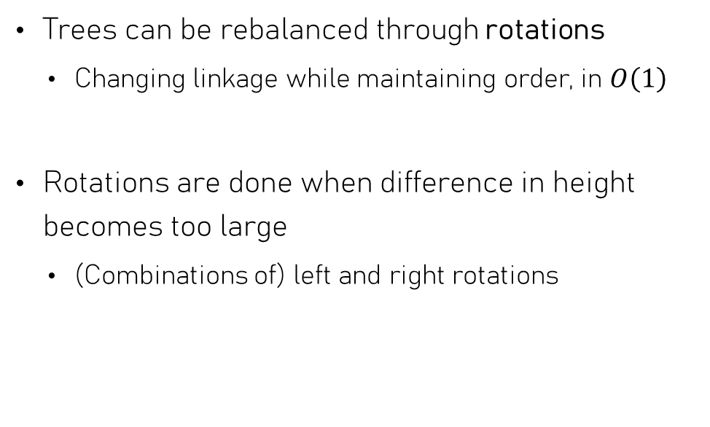

Self-balancing Binary Search Trees
Trees can be rebalanced through rotations
  Changing linkage while maintaining order, in $O\left(1\right)$
Rotations are done when difference in height becomes too large
  (Combinations of) left and right rotations
F
B
G
A
D
$$ΔH = 2$$
C
E
Need to rotate rightwards eventually, but first rotate this part left

Slide 25

Self-balancing Binary Search Trees
Trees can be rebalanced through rotations
  Changing linkage while maintaining order, in $O\left(1\right)$
Rotations are done when difference in height becomes too large
  (Combinations of) left and right rotations
F
B
G
A
D
C
E

Slide 26
Self-balancing Binary Search Trees
Trees can be rebalanced through rotations
  Changing linkage while maintaining order, in $O\left(1\right)$
Rotations are done when difference in height becomes too large
  (Combinations of) left and right rotations
F
D
G
B
E
$$ΔH = 2$$
A
C

Slide 27
Self-balancing Binary Search Trees
Trees can be rebalanced through rotations
  Changing linkage while maintaining order, in $O\left(1\right)$
Rotations are done when difference in height becomes too large
  (Combinations of) left and right rotations
F
D
G
B
E
A
C

Slide 28
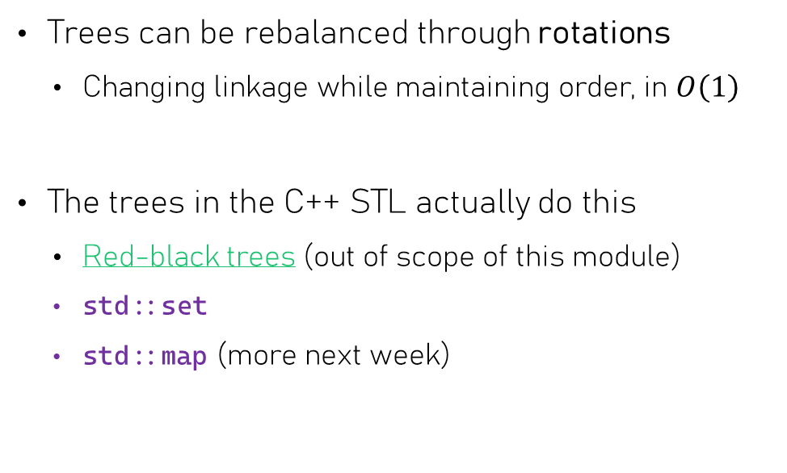
Self-balancing Binary Search Trees
Trees can be rebalanced through rotations
  Changing linkage while maintaining order, in $O\left(1\right)$
The trees in the C++ STL actually do this
  Red-black trees (out of scope of this module)
  std::set
  std::map (more next week)
D
B
F
A
C
E
G
Homework: what would’ve happened if we hadn’t performed the leftward rotation first?

Slide 29
Binary Tree Traversal
Replacing recursion with a stack

Slide 30
Binary Search Trees – Traversal
Let’s print the contents of a binary tree… How?
  Need to go left first, then right
  Loop-based iteration can only go one way
  Recursion to the rescue!
root
Date
Banana
Orange
Problem: print contents of tree
Approach:
Print contents of left subtree
Print contents of right subtree
Simplest problem: print contents of empty tree
Apple
Cherry
Mango
Pear
Fig

Slide 31
Binary Search Trees – Traversal
Let’s print the contents of a binary tree… How?
  Need to go left first, then right
  Loop-based iteration can only go one way
  Recursion to the rescue!
root
Date
Banana
Orange
void print(const Node* root) {
if (!root) return; // empty tree
print(root->left); // recurse
std::cout << root->data << ', ';
print(root->right); // recurse
}
Apple
Cherry
Mango
Pear
Fig

Slide 32
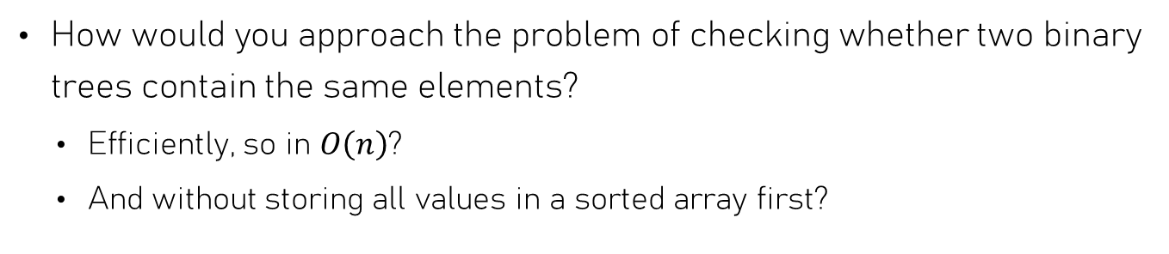
BST – Set equality
Simple – store values in two sorted arrays and apply two-pointer technique
Simple – use recursion to traverse left tree and check if values are in right tree, and then the other way around
How would you approach the problem of checking whether two binary trees contain the same elements?
  Efficiently, so in $O\left(n\right)$?
  And without storing all values in a sorted array first?
Date
Banana
Banana
Fig
Apple
Date
Apple
Cherry
Cherry
Fig

Slide 33
Binary Search Trees – Traversal
Can’t we “simulate” recursion using loops?
Recursion is great, but we can’t iterate the values of a tree with it
Recursion works by “pushing” new function calls onto the call stack.
When a subproblem is solved, the function call is “popped” from the call stack & work continues
root
Date
Banana
Orange
Apple
Cherry
Mango
Pear
Fig

Slide 34
Stacks & recursion
t
Stack of tasks
Answer Phone
A stack allow you to postpone the completion of a task
  Start & complete another before continuing with current
Always work on the task at the top of the stack
  Push new task onto the stack
  On completion, pop current task
Tasks are done in LIFO order: Last In, First Out
Find money
Handle Pizza Delivery
Join friends
Clean the house
Homework

Slide 35
BSTs – Stack-based traversal
t
Stack of tasks
Task: printing the value of a Node
Before completing a task, first move left & start task
After completing a task, move right & start task
Print Apple
Date
Print Mango
Print Cherry
Print Banana
Banana
Orange
Print Orange
Print Date
Print Pear
Apple
Cherry
Mango
Pear

Slide 36
BST Traversal – advanced “pointers”
Assignment 2
Wouldn’t it be nice if we could traverse a tree easily?
  Similar to like we traverse a linked list or vector?
We can achieve this by making node_ptr
  Have a constructor that takes a const Node*
  Have “memory” in the form of a stack
  Implement the arrow (->) and bool operator
  Implement move_next
void print(const Node* node) {
node_ptr current = node;
while (current) {
cout << current->data;
current.move_next();
}
}
class node_ptr {
public:
node_ptr(const Node* node);
const Node* operator->() const;
operator bool() const;
void move_next();
}

Slide 37
BST – Set equality
Date
Banana
Fig
Verifying whether two BSTs represent the same set of elements is now easy:
Apple
Cherry
bool equal_sets(const Node* a, const Node* b) {
node_ptr pa{a}, pb{b};
while (pa && pb) {
if (pa->data != pb->data) return false;
pa.move_next();
pb.move_next();
}
if (pa || pb) return false;
return true;
}
Banana
Apple
Date
Both pointers should be nullptr
Cherry
Fig

Slide 38
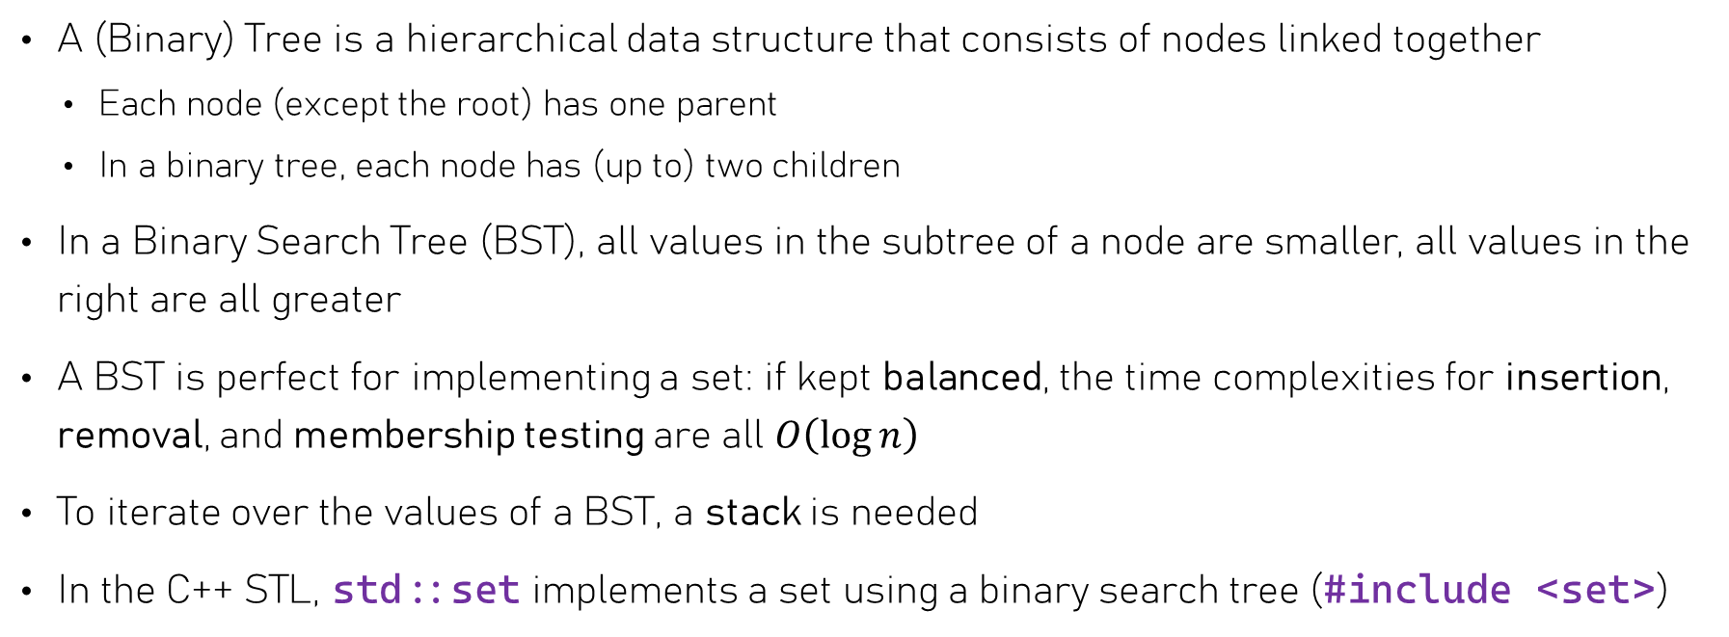
Summary
A (Binary) Tree is a hierarchical data structure that consists of nodes linked together
  Each node (except the root) has one parent
  In a binary tree, each node has (up to) two children
In a Binary Search Tree (BST), all values in the subtree of a node are smaller, all values in the right are all greater
A BST is perfect for implementing a set: if kept balanced, the time complexities for insertion, removal, and membership testing are all $O\left(\log{n}\right)$
To iterate over the values of a BST, a stack is needed
In the C++ STL, std::set implements a set using a binary search tree (#include <set>)

